Slide 1
Network and Information Security
Sem VI

Slide 2
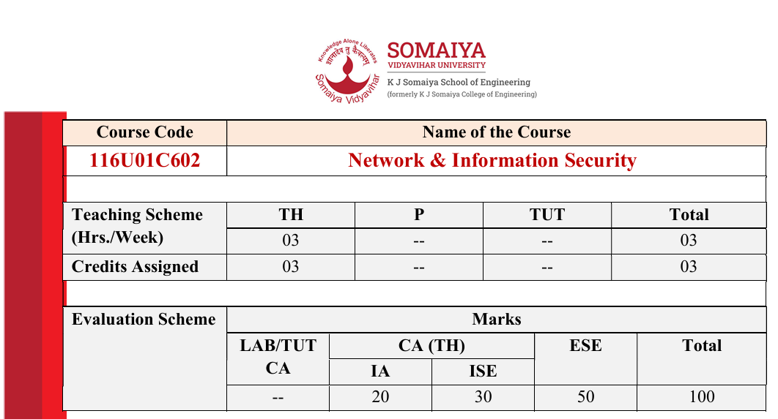

Slide 3
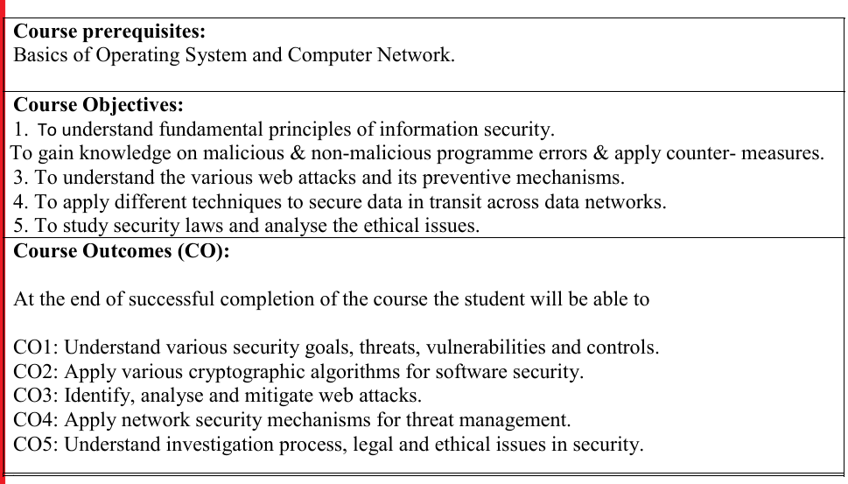

Slide 4
What is Information Security
Information security is the practice of protecting information by mitigating information risks.
It involves the protection of information systems and the information processed, stored, and transmitted by these systems from unauthorized access, use, disclosure, disruption, modification, or destruction.
This includes the protection of personal information, financial information, and sensitive or confidential information stored in both digital and physical forms.
Effective information security requires a comprehensive and multi-disciplinary approach, involving people, processes, and technology.

Slide 5
What is InfoSec?
Information Security is basically the practice of preventing unauthorized access, use, disclosure, disruption, modification, inspection, recording, or destruction of information.
Information can be a physical or electronic one. Information can be anything like Your details or we can say your profile on social media, your data on your mobile phone, your biometrics, etc.

Slide 6
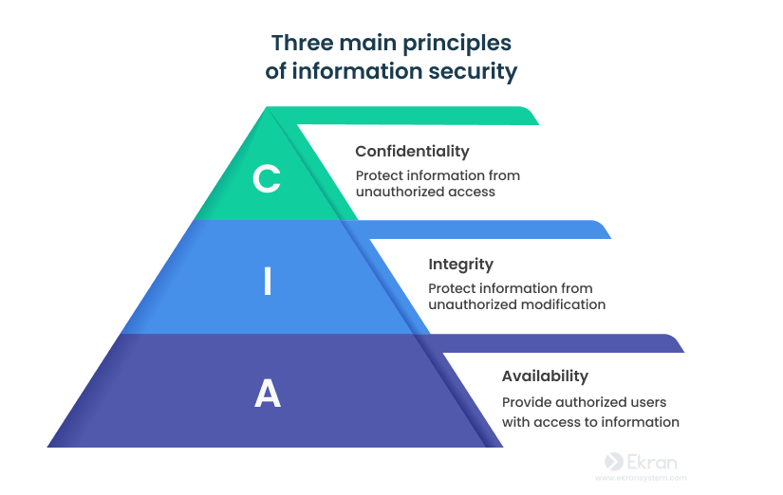
3 Principles of Information Security?

Slide 7
Confidentiality: Keeping data secret from unauthorized eyes (e.g., encryption, access controls).
Integrity: Ensuring data is accurate and hasn't been altered (e.g., digital signatures, change management).
Availability: Making sure authorized users can access data when needed (e.g., backups, disaster recovery)

Slide 8
Components & Practices
People: Trained employees, security awareness.
Processes: Policies, procedures, risk management, incident response.
Technology: Firewalls, antivirus, encryption, cloud security, endpoint security.

Slide 9
Threat
A threat is a possible security violation that may exploit a system’s weakness. It can originate from accidents, natural disasters, human error, or intentional actions. The main threat categories include interruption, interception, fabrication, and modification.

Slide 10
Unstructured Threats: Caused by inexperienced individuals using simple tools like shell scripts or password crackers.
Structured Threats: Organized, targeted attempts by skilled and motivated hackers to breach a specific network or company.
External Threats: Originating from outside the organization. Attackers gain unauthorized access via the internet or remote access points.
Internal Threats: Caused by users who already have authorized access, whether through accounts or physical access.

Slide 11
Types of Attack
Active Attack: The attacker alters, damages, or takes control of the system (e.g., malware injection, data theft, server crashes). Like someone breaking into your house and tampering with things.
Passive Attack: The attacker silently monitors or steals information without making changes. Like someone secretly reading your messages.

Slide 12
Types of active attacks
Masquerade Attack
Modification of Messages
Repudiation
Replay Attack
Denial of Service(DoS) Attack

Slide 13
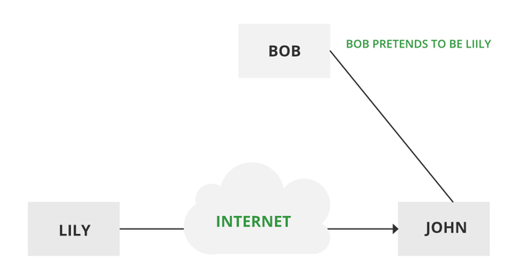
Masquerade Attack
Masquerade attacks are considered one type of cyber attack in which the attacker disguises himself to pose as some other person and accesses systems or data.
Username and Password Masquerade
IP address masquerade
Website masquerade
Email masquerade
Notes:
Username and Password Masquerade: In this masquerade attack, a person uses either stolen or even forged credentials to authenticate themselves as a valid user while gaining access to the system or application.
IP address masquerade: This is an attack where the IP address of a malicious user is spoofed or forged such that the source from which the system or the application is accessed appears to be trusted.
Website masquerade: A hacker creates a fake website that resembles as a legitimate one in order to gain user information or even download malware.
Email masquerade: This is an e-mail masquerade attack through which an attacker sends an apparently trusted source email so that the recipient can mistakely share sensitive information or download malware.

Slide 14
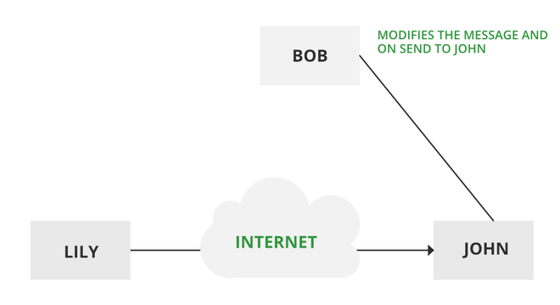
Modification of Messages
This is when someone changes parts of a message without permission, or mixes up the order of messages, to cause trouble. Imagine someone secretly changing a letter you sent, making it say something different. This kind of attack breaks the trust in the information being sent. For example, a message meaning “Allow JOHN to read confidential file X” is modified as “Allow Smith to read confidential file X”.

Slide 15
Repudiation
Repudiation attacks are a type of cyber attack wherein some person does something damaging online, such as a financial transaction or sends a message one does not want to send, then denies having done it. Such attacks can seriously hinder the ability to trace down the origin of the attack or to identify who is responsible for a given action, making it tricky to hold responsible the right person. Types:
Message repudiation attacks
Transaction repudiation attacks
Data repudiation attacks

Slide 16
Replay Attack
It is a passive capturing of a message with an objective to transmit it for the production of an authorized effect.
Thus, in this type of attack, the main objective of an attacker is saving a copy of the data that was originally present on that particular network and later on uses it for personal uses.
Once the data gets corrupted or leaked it becomes an insecure and unsafe tool for its users.

Slide 17
Denial of Service(DoS) Attack
Denial of Service (DoS) is a form of cybersecurity attack that involves denying the intended users of the system or network access by flooding traffic or requests. In this DoS attack, the attacker floods a target system or network with traffic or requests in order to consume the available resources such as bandwidth, CPU cycles, or memory and prevent legitimate users from accessing them.
Types of DoS attacks:
Flood attacks: Here, an attacker sends such a large number of packets or requests to a system or network that it cannot handle them all and the system gets crashed.
Amplification attacks: In this category, the attacker increases the power of an attack by utilizing another system or network to increase traffic then directs it all into the target to boost the strength of the attack.

Slide 18
Threat | Attack
A possible danger or risk. | Actual harmful action.
Can be intentional or unintentional. | Always intentional.
May or may not be malicious. | Always malicious.
May or may not cause damage. | Aims to cause damage.
Harder to detect. | Easier to detect.
Can be prevented by controlling vulnerabilities. | Cannot be stopped by vulnerability control alone.
May come from internal, external, physical, or non-physical sources. | Comes from malware, phishing, botnets, ransomware, DoS, breaches, etc.

Slide 19
Vulnerabilities
Vulnerabilities are weaknesses in a system that give threats the opportunity to compromise an individual's or an organisation's assets.
As the attackers are leveling up their attacking mechanisms, the number of vulnerable assets is increasing too.
These could include the code, human weaknesses, unpatched software, improper authentication mechanisms, etc.

Slide 20
Types of Vulnerabilities
Hardware Vulnerability
Software Vulnerability
Network Vulnerability
Procedural Vulnerability
Human Vulnerability

Slide 21
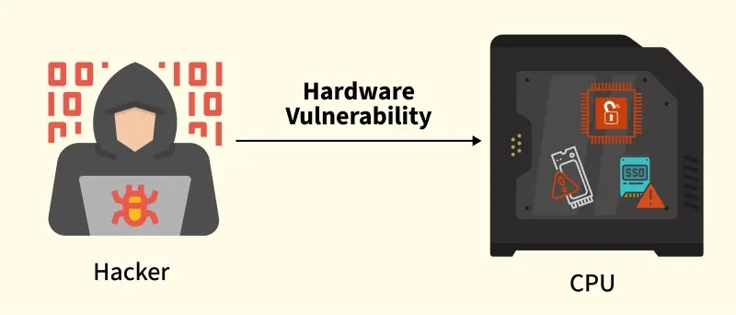
Hardware Vulnerability
Weaknesses or flaws in physical devices (like computers or routers) that hackers can exploit to gain unauthorized access or cause damage.
Physical Attacks: Hardware devices like servers, laptops, or smartphones are susceptible to physical attacks. Attackers may gain access to critical systems by stealing or tampering with hardware.
Firmware Vulnerabilities: The software that runs on hardware, known as firmware, can have vulnerabilities. Flaws in firmware can lead to persistent attacks, as they are not always detected or patched as frequently as software

Slide 22
Software Vulnerability
Causes of Hardware Vulnerability
Old version of systems or devices
Unprotected storage
Unencrypted devices, etc.
How to Prevent Hardware Vulnerability:
Encrypt Sensitive Data: Ensure that all hardware, such as laptops and smartphones, is encrypted to protect data from unauthorized access in case of theft.
Use Strong Authentication: Implement biometric or multi-factor authentication on devices to enhance security.
Secure Devices Physically: Lock hardware devices in secure locations to prevent physical tampering or theft.
Keep Hardware Up-to-Date: Regularly update hardware firmware to patch vulnerabilities and ensure the latest security measures are in place.

Slide 23
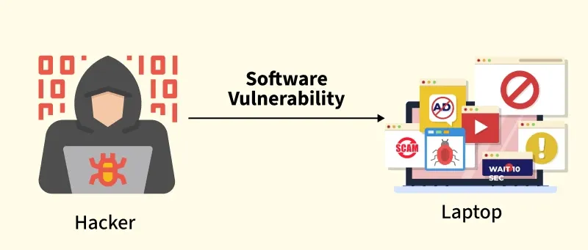
Software Vulnerability:
Flaws or bugs in software (such as apps or operating systems) that can be used by hackers to compromise the system, often due to coding mistakes or outdated software.
Unpatched Software
Buffer Overflow
Insecure Code
Weak Authentication

Slide 24
Causes of Software Vulnerabilities
Lack of input validation
Unverified uploads
Cross-site scripting
Unencrypted data, etc.
How to Prevent Software Vulnerability:
Regular Patching and Updates: Apply software patches and updates as soon as they are released. Many vulnerabilities arise due to outdated software.
Secure Coding Practices: Developers should use secure coding practices to avoid common software vulnerabilities such as SQL injection and buffer overflows.
Use Antivirus Software: Install and regularly update antivirus and anti-malware software to detect and remove malicious code.
Apply Proper Input Validation: Ensure that input validation checks are in place to prevent attacks like cross-site scripting (XSS) and SQL injection.

Slide 25
Network Vulnerability
A network vulnerability is a weakness or flaw in the design, implementation, or configuration of a computer network that attackers can exploit to gain unauthorized access, steal data, or disrupt services. These vulnerabilities can exist in hardware (routers, switches), software (servers, protocols), or network configurations.
Unsecured Wireless Networks: Wi-Fi networks that are not properly secured with strong passwords or encryption can be easily accessed by attackers. Once inside the network, an attacker can intercept communications, gain access to devices, or launch attacks against connected systems.
Open Ports: Unnecessary or open ports on a device can serve as gateways for attackers to exploit. Proper configuration of firewalls is essential to ensure only necessary ports are open and accessible.
Man-in-the-Middle (MITM) Attacks: In MITM attacks, attackers intercept and alter the communication between two parties. If sensitive information such as login credentials or financial data is transmitted unencrypted, it can be captured and misused.

Slide 26
Causes of Network Vulnerability
Unprotected communication
Malware or malicious software (e.g.:Viruses, Keyloggers, Worms, etc)
Social engineering attacks
Misconfigured firewalls
How to Prevent Network Vulnerability:
Use Strong Encryption: Ensure that sensitive data is encrypted during transmission over the network using protocols like SSL/TLS.
Secure Wi-Fi Networks: Use strong passwords and encryption (WPA3) on wireless networks to prevent unauthorized access.
Firewalls and IDS/IPS: Implement firewalls to block unauthorized network traffic and use Intrusion Detection Systems (IDS) or Intrusion Prevention Systems (IPS) to monitor and protect network traffic.
Limit Open Ports: Close unnecessary open ports on devices to reduce attack surfaces. Regularly audit the network for exposed ports.

Slide 27
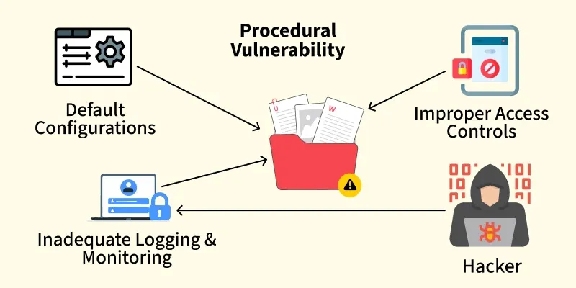
Procedural Vulnerability
Weaknesses in the processes or rules organizations follow, like using default passwords or failing to monitor activities, which can allow attackers to bypass security.

Slide 28
Default Configurations: Many devices, applications, and systems come with default settings that are not optimized for security. Leaving these defaults unchanged, such as using default administrator passwords, can provide attackers with an easy way into the system.
Improper Access Controls: Misconfiguring access control settings, such as leaving sensitive data accessible to unauthorized users, can expose systems to exploitation. Role-based access control (RBAC) and least privilege access are essential to minimize this risk.
Inadequate Logging and Monitoring: Failure to implement adequate logging and monitoring can prevent organizations from detecting unauthorized access or malicious activities in a timely manner. A lack of monitoring can allow an attacker to maintain persistent access without detection.

Slide 29
How to Prevent Procedural Vulnerability:
Change Default Configurations: Always change default configurations on devices, software, and network devices to ensure stronger security.
Role-Based Access Control (RBAC): Implement RBAC to ensure that employees have access only to the information they need for their job.
Regular Monitoring and Logging: Establish robust logging and monitoring practices to detect and respond to unusual activity promptly.
Use the Principle of Least Privilege (PoLP): Only grant users the minimum level of access necessary for them to perform their duties.

Slide 30
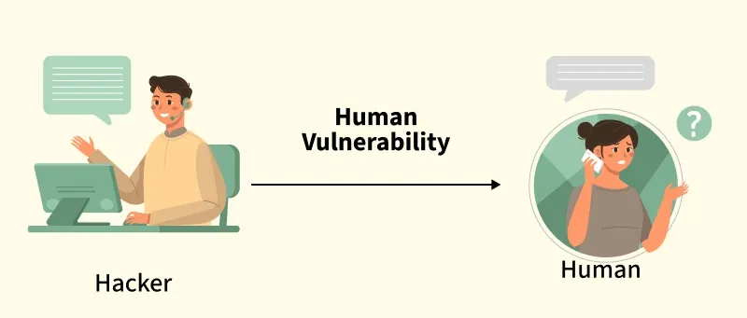
Human Vulnerabilities
Security risks caused by human behavior, such as falling for phishing attacks, using weak passwords, or not being aware of security threats, making it easier for hackers to exploit the system.

Slide 31
Social Engineering: Human behavior is often the weakest link in cyber security. Attackers use social engineering tactics to manipulate individuals into disclosing confidential information or performing actions that compromise security. Phishing, baiting, and pretexting are common social engineering methods.
Negligence: Employees or users may inadvertently introduce vulnerabilities through negligence, such as using weak passwords, sharing login credentials, or failing to lock their devices when not in use. This makes them easy targets for attackers.
Lack of Security Awareness: A lack of training and awareness about cyber security best practices can leave individuals and organizations vulnerable to attacks. Users may fail to recognize phishing emails or may click on malicious links without thinking.

Slide 32
How to Prevent Human Vulnerability:
Security Awareness Training: Conduct regular cyber security training for employees to help them identify phishing attacks, social engineering tactics, and other malicious activities.
Use Strong Passwords and Multi-Factor Authentication (MFA): Encourage the use of complex passwords and MFA to secure user accounts.
Regular Security Audits: Perform regular audits of employee behavior and access permissions to ensure compliance with security policies.
Be Cautious of Suspicious Emails and Links: Train users to avoid clicking on unknown links, opening suspicious email attachments, or entering sensitive information on untrusted websites.

Slide 33
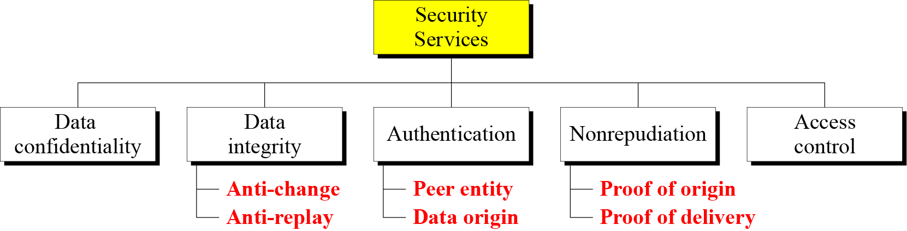
1.3.1 Security Services
Figure 1.3 Security services

Slide 34
Security Services
Security services are mechanisms designed to protect data and communication systems from threats such as unauthorized access, modification, or misuse.
Data Confidentiality
Purpose: Ensures that information is not disclosed to unauthorized users.
How: Encryption, secure communication channels.
Example: Only the intended receiver can read an encrypted email.
Data Integrity
Purpose: Ensures that data is not altered during storage or transmission.
Sub-services:
Anti-change: Prevents unauthorized modification of data.
Anti-replay: Prevents attackers from capturing and re-sending old messages.
Example: Hash functions and Message Authentication Codes (MACs).
Authentication
Purpose: Confirms the identity of entities involved in communication.
Sub-services:
Peer entity authentication: Verifies the identity of the communicating parties (e.g., user login).
Data origin authentication: Confirms that data comes from a legitimate source.
Example: Passwords, biometrics, digital certificates.

Slide 35
Authentication
Purpose: Confirms the identity of entities involved in communication.
Sub-services:
Peer entity authentication: Verifies the identity of the communicating parties (e.g., user login).
Data origin authentication: Confirms that data comes from a legitimate source.
Example: Passwords, biometrics, digital certificates.
Nonrepudiation
Purpose: Prevents a sender or receiver from denying an action they performed.
Sub-services:
Proof of origin: Sender cannot deny sending the message.
Proof of delivery: Receiver cannot deny receiving the message.
Example: Digital signatures in legal or financial transactions.

Slide 36
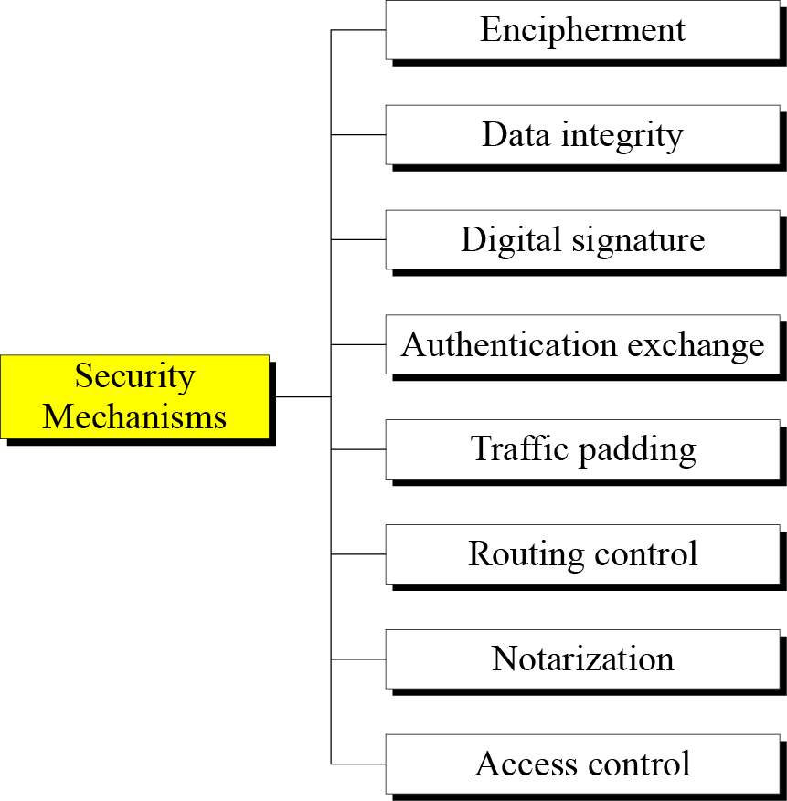
1.3.2 Security Mechanism
Figure 1.4 Security mechanisms

Slide 37
Encipherment : This security mechanism deals with hiding and covering of data which helps data to become confidential. It is achieved by applying mathematical calculations or algorithms which reconstruct information into not readable form. It is achieved by two famous techniques named Cryptography and Encipherment. Level of data encryption is dependent on the algorithm used for encipherment.
Access Control : This mechanism is used to stop unattended access to data which you are sending. It can be achieved by various techniques such as applying passwords, using firewall, or just by adding PIN to data.
Notarization : This security mechanism involves use of trusted third party in communication. It acts as mediator between sender and receiver so that if any chance of conflict is reduced. This mediator keeps record of requests made by sender to receiver for later denied.

Slide 38
Data Integrity : This security mechanism is used by appending value to data to which is created by data itself. It is similar to sending packet of information known to both sending and receiving parties and checked before and after data is received. When this packet or data which is appended is checked and is the same while sending and receiving data integrity is maintained.
Authentication Exchange : This security mechanism deals with identity to be known in communication. This is achieved at the TCP/IP layer where two-way handshaking mechanism is used to ensure data is sent or not
Bit Stuffing : This security mechanism is used to add some extra bits into data which is being transmitted. It helps data to be checked at the receiving end and is achieved by Even parity or Odd Parity.
Digital Signature : This security mechanism is achieved by adding digital data that is not visible to eyes. It is form of electronic signature which is added by sender which is checked by receiver electronically. This mechanism is used to preserve data which is not more confidential but sender's identity is to be notified.

Slide 39
1.3.3 Relation between Services and Mechanisms
Table 1.2 Relation between security services and mechanisms

Slide 40
1-4 TECHNIQUES
Mechanisms discussed in the previous sections are only theoretical recipes to implement security. The actual implementation of security goals needs some techniques. Two techniques are prevalent today: cryptography and steganography.
Topics discussed in this section:
1.4.1 Cryptography 1.4.2 Steganography

Slide 41
1.4.1 Cryptography
Cryptography, a word with Greek origins, means “secret writing.” However, we use the term to refer to the science and art of transforming messages to make them secure and immune to attacks.

Slide 42
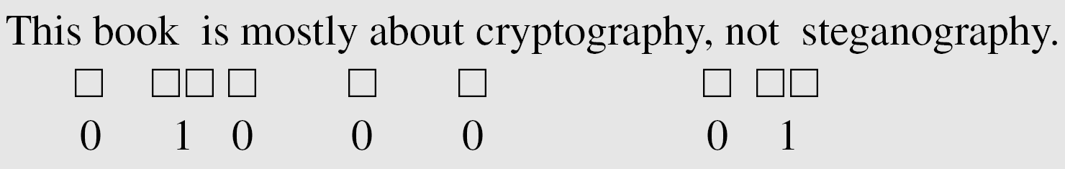
1.4.2 Steganography
The word steganography, with origin in Greek, means “covered writing,” in contrast with cryptography, which means “secret writing.”
Example: covering data with text

Slide 43
1.4.2 Continued
Example: using dictionary
Example: covering data under color image

Slide 44
Conventional Cryptographic Techniques

Slide 45
Substitution Cipher
Ceasor Cipher
Monoalphabetic Cipher
Polyalphabetic Cipher

Slide 46
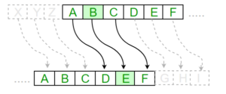
Ceasor Cipher
The encryption can be represented using modular arithmetic by first transforming the letters into numbers, according to the scheme, A = 0, B = 1,…, Z = 25.

Slide 47
Plain Text: ABCDEFGHIJKLMNOPQRSTUVWXYZ Key: 4 Output: EFGHIJKLMNOPQRSTUVWXYZabcd
Plain Text: I am studying Data Encryption Key: 4 Output: M eq wxyhCmrk Hexe IrgvCtxmsr

Slide 48
Algorithm for Substitution Cipher:
Input:
A String of both lower and upper case letters, called PlainText.
An Integer denoting the required key.
Procedure:
Create a list of all the characters.
Create a dictionary to store the substitution for all characters.
For each character, transform the given character as per the rule, depending on whether we’re encrypting or decrypting the text.
Print the new string generated.

Slide 49
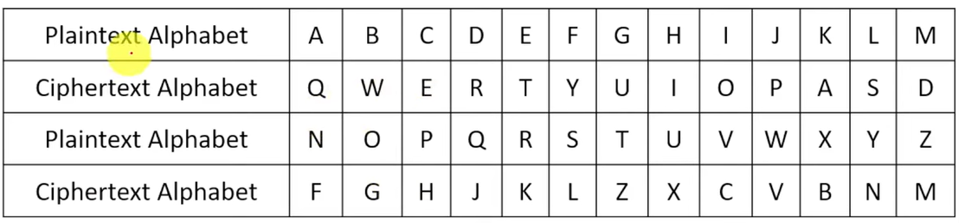
Monoalphabetic Cipher
A monoalphabetic cipher is any cipher in which the letters of the plain text are mapped to cipher text letters based on a single alphabetic key.

Slide 50
Polyalphabetic Cipher
A polyalphabetic cipher is any cipher based on substitution, using multiple substitution alphabets.
Example:
Consider the Plain Text: ATTACKATDAWN
Keyword:LEMON

Slide 51
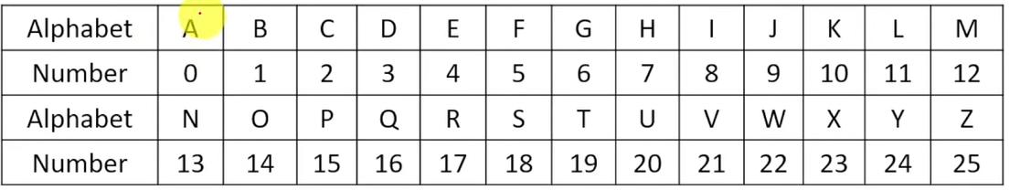
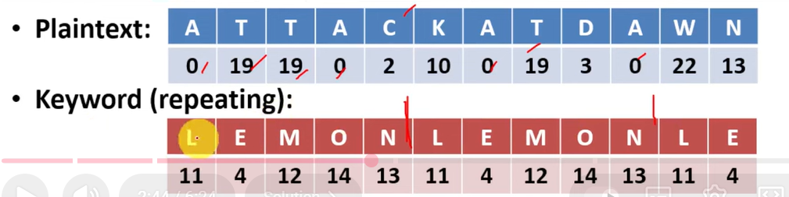
Step 1: Convert the Alphabets into number.

Slide 52
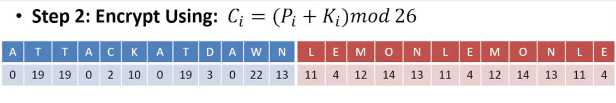
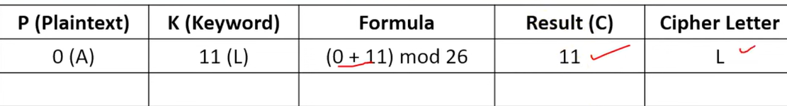

Slide 53
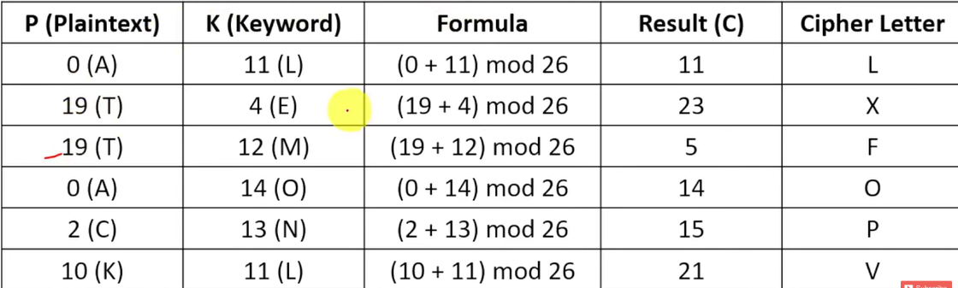

Slide 54
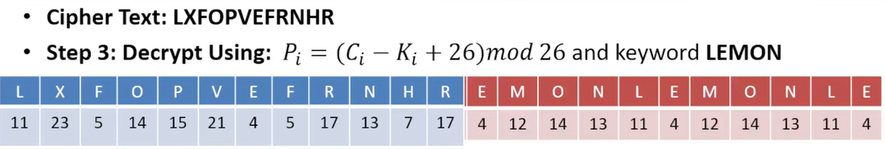
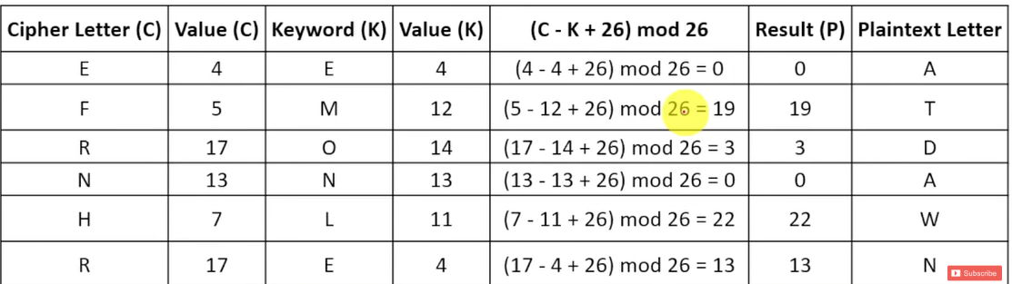

Slide 55
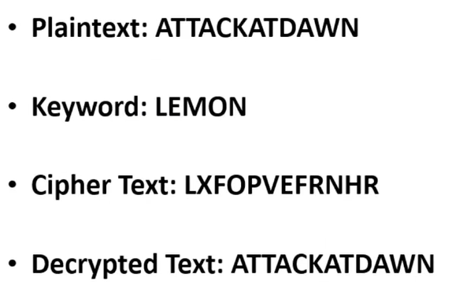

Slide 56
Monoalphabetic Cipher | Polyalphabetic Cipher
A monoalphabetic cipher is one where each symbol in plain text is mapped to a fixed symbol in cipher text. | Polyalphabetic cipher is any cipher based on substitution, using multiple substitution alphabets.
The relationship between a character in the plain text and the characters in the cipher text is one-to-one. | The relationship between a character in the plain text and the characters in the cipher text is one-to-many.
Each alphabetic character of plain text is mapped onto a unique alphabetic character of a cipher text. | Each alphabetic character of plain text can be mapped onto 'm' alphabetic characters of a cipher text.
A stream cipher is a monoalphabetic cipher if the value of key does not depend on the position of the plain text character in the plain text stream. | A stream cipher is a polyalphabetic cipher if the value of key does depend on the position of the plain text character in the plain text stream.
It includes additive, multiplicative, affine and monoalphabetic substitution cipher. | It includes autokey, Playfair, Vigenere, Hill, one-time pad, rotor, and Enigma cipher.
It is a simple substitution cipher. | It is multiple substitutions cipher.
Monoalphabetic Cipher is described as a substitution cipher in which the same fixed mappings from plain text to cipher letters across the entire text are used. | Polyalphabetic Cipher is described as substitution cipher in which plain text letters in different positions are enciphered using different cryptoalphabets.
Monoalphabetic ciphers are not that strong as compared to polyalphabetic cipher. | Polyalphabetic ciphers are much stronger

Slide 57
Playfair cipher
The Playfair cipher was the first practical digraph substitution cipher.
The scheme was invented in 1854 by Charles Wheatstone but was named after Lord Playfair who promoted the use of the cipher.
In playfair cipher unlike traditional cipher we encrypt a pair of alphabets(digraphs) instead of a single alphabet.
It was used for tactical purposes by British forces in the Second Boer War and in World War I and for the same purpose by the Australians during World War II.
This was because Playfair is reasonably fast to use and requires no special equipment.

Slide 58
The algorithm consists of 2 steps:
Generate the key Square (5x5):
The key square is a 5×5 grid of alphabets that acts as the key for encrypting the plaintext. Each of the 25 alphabets must be unique and one letter of the alphabet (usually J) is omitted from the table (as the table can hold only 25 alphabets). If the plaintext contains J, then it is replaced by I.
The initial alphabets in the key square are the unique alphabets of the key in the order in which they appear followed by the remaining letters of the alphabet in order.
Algorithm to encrypt the plain text: The plaintext is split into pairs of two letters (digraphs). If there is an odd number of letters, a Z is added to the last letter.

Slide 59
Examples
PlainText: "instruments" After Split: 'in' 'st' 'ru' 'me' 'nt' 'sz' Explanation: Pair cannot be made with same letter. Break the letter in single and add a bogus letter to the previous letter. Here 'z' is the bogus letter.
Plain Text: "hello" After Split: 'he' 'lx' 'lo' Explanation: Here 'x' is the bogus letter.
Plain Text: "helloe" After Split: 'he' 'lx' 'lo' 'ez' Explanation: If the letter is standing alone in the process of pairing, then add an extra bogus letter with the alone letter. Here 'x' and 'z' are the bogus letters.

Slide 60
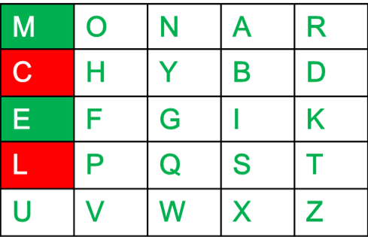

Slide 61
Rules for Encryption
If both the letters are in the same column: Take the letter below each one (going back to the top if at the bottom).
For example: Diagraph: "me" Encrypted Text: cl Encryption: m -> c e -> l

Slide 62
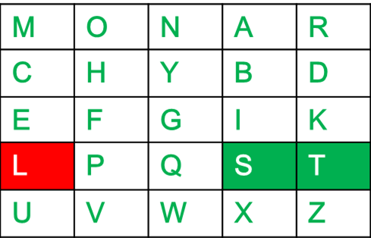
If both the letters are in the same row: Take the letter to the right of each one (going back to the leftmost if at the rightmost position).
For example: Diagraph: "st" Encrypted Text: tl Encryption: s -> t t -> l

Slide 63
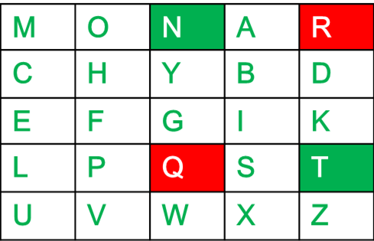
If neither of the above rules is true: Form a rectangle with the two letters and take the letters on the horizontal opposite corner of the rectangle.
For example: Diagraph: "nt" Encrypted Text: rq Encryption: n -> r t -> q

Slide 64
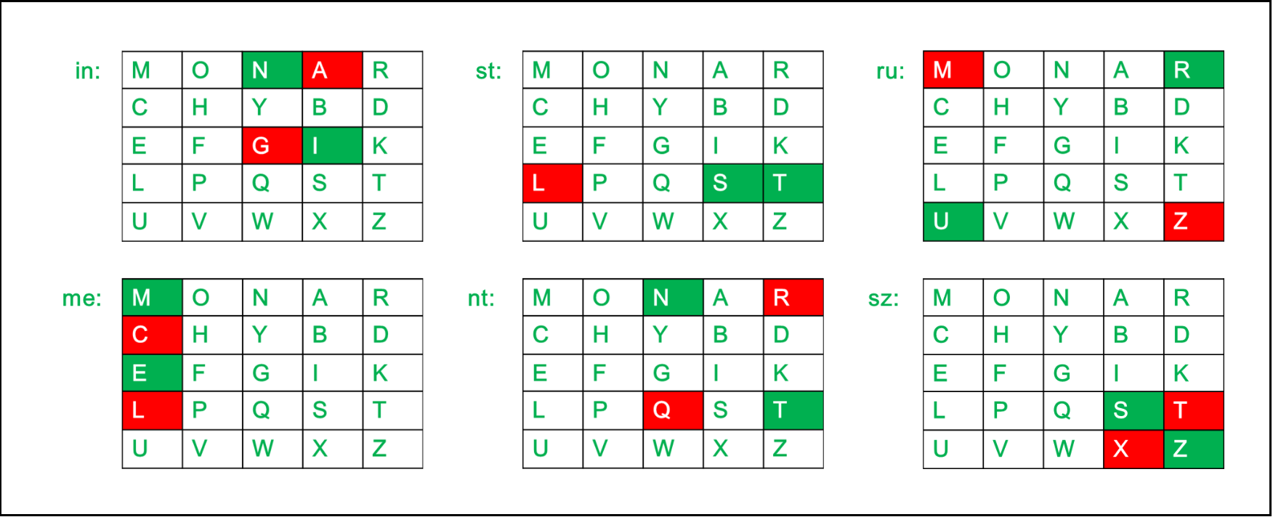
For example: Plain Text: "instrumentsz" Encrypted Text: gatlmzclrqtx Encryption: i -> g n -> a s -> t t -> l r -> m u -> z m -> c e -> l n -> r t -> q s -> t z -> x

Slide 65
Rules for Decryption
If both the letters are in the same column: Take the letter above each one (going back to the bottom if at the top). For example: Diagraph: "cl" Decrypted Text: me Decryption: c -> m l -> e

Slide 66

If both the letters are in the same row: Take the letter to the left of each one (going back to the rightmost if at the leftmost position). For example: Diagraph: "tl" Decrypted Text: st Decryption: t -> s l -> t

Slide 67
If neither of the above rules is true: Form a rectangle with the two letters and take the letters on the horizontal opposite corner of the rectangle. For example: Diagraph: "rq" Decrypted Text: nt Decryption: r -> n q -> t

Slide 68

For example: Plain Text: "gatlmzclrqtx" Decrypted Text: instrumentsz Decryption: (red)-> (green) ga -> in tl -> st mz -> ru cl -> me rq -> nt tx -> sz

Slide 69
Hill Cipher
Hill cipher is a polygraphic substitution cipher based on linear algebra.Each letter is represented by a number modulo 26.
Often the simple scheme A = 0, B = 1, ..., Z = 25 is used, but this is not an essential feature of the cipher.
To encrypt a message, each block of n letters (considered as an n-component vector) is multiplied by an invertible n × n matrix, against modulus 26.
To decrypt the message, each block is multiplied by the inverse of the matrix used for encryption.
The matrix used for encryption is the cipher key, and it should be chosen randomly from the set of invertible n × n matrices (modulo 26).

Slide 70
Example
Input : Plaintext: ACT
Key: GYBNQKURP
Output : Ciphertext: POH

Slide 71
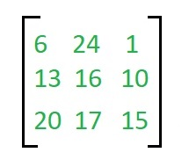

Encryption
We have to encrypt the message 'ACT' (n=3).The key is 'GYBNQKURP' which can be written as the nxn matrix:
The message 'ACT' is written as vector:

Slide 72
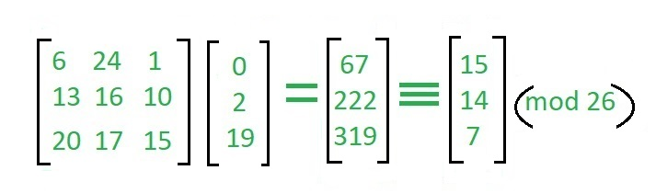
The enciphered vector is given as:
which corresponds to ciphertext of 'POH'

Slide 73
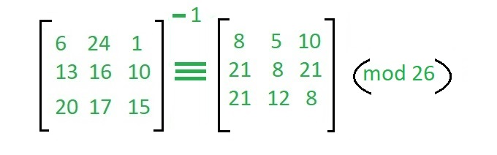
Decryption
To decrypt the message, we turn the ciphertext back into a vector, then simply multiply by the inverse matrix of the key matrix (IFKVIVVMI in letters).
The inverse of the matrix used in the previous example is:

Slide 74
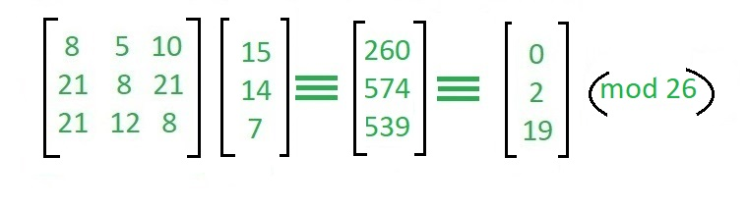
For the previous Ciphertext 'POH':
which gives us back 'ACT'. Assume that all the alphabets are in upper case. Below is the implementation of the above idea for n=3.

Slide 75
One Time Pad
The two requirements for the One-Time pad are:
The key should be randomly generated as long as the size of the message.
The key is to be used to encrypt and decrypt a single message, and then it is discarded.

Slide 76
Input: Message = HELLO,
Key = MONEY
Output: Cipher - TSYPM,
Message - HELLO
Explanation: Part 1: Plain text to Ciphertext
Plain text — H E L L O ? 7 4 11 11 14
Key — M O N E Y ? 12 14 13 4 24
Plain text + key ? 19 18 24 15 38
Cipher Text ? T S Y P M
Part 2: Ciphertext to Message
Cipher Text — T S Y P M ? 19 18 24 15 12
Key — M O N E Y? 12 14 13 4 24
Cipher text - key ? 7 4 11 11 -12 ? 7 4 11 11 14
Message ? H E L L O

Slide 77
Transposition Cipher
The Transposition Cipher Technique is an encryption method used to encrypt a message or information.
This encryption method is done by playing with the position of letters of the plain text.
The positions of the characters present in the plaintext are rearranged or shifted to form the ciphertext.
It makes use of some kind of permutation function to achieve the encryption purpose.
It is very easy to use and so simple to implement.

Slide 78
Types of Transposition Cipher Techniques
Rail Fence Transposition Cipher
Block (Single Columnar) Transposition Cipher
Double Columnar Transposition Cipher

Slide 79
Rail Fence Transposition Cipher
Rail Fence Transposition cipher technique is the simplest transposition cipher technique.
It is also termed as a zigzag cipher.
It gets its name from the way through which it performs encryption of plain text.

Slide 80
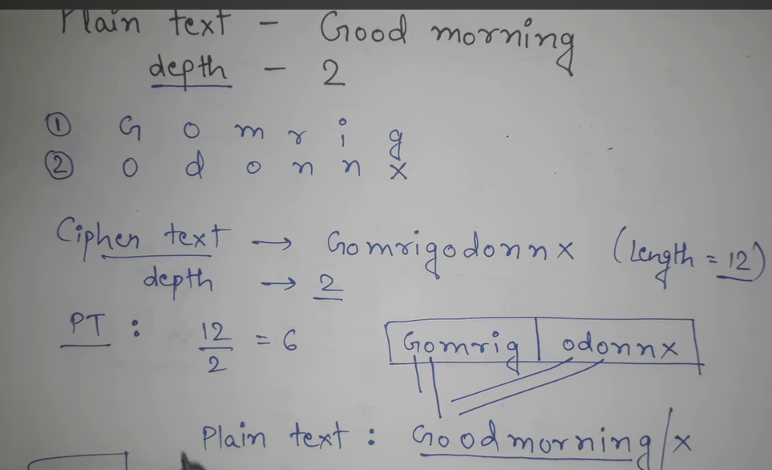

Slide 81
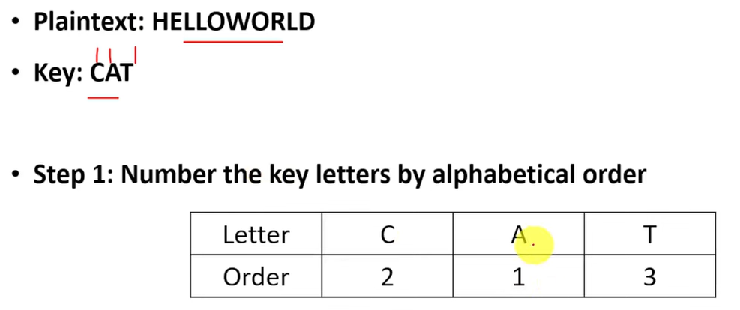
Block (Single Columnar) Transposition Cipher

Slide 82
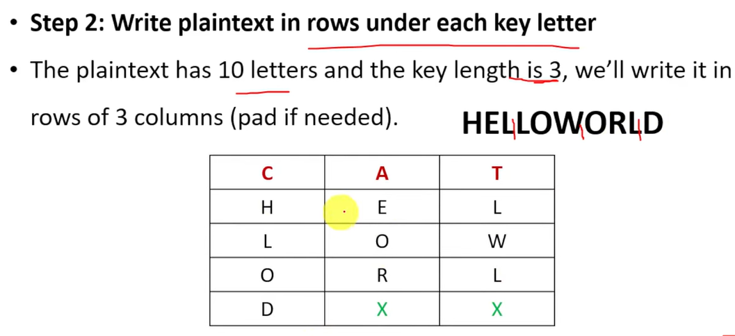

Slide 83
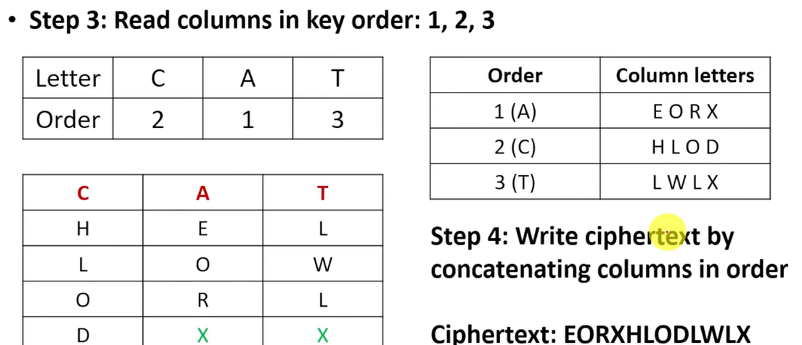

Slide 84
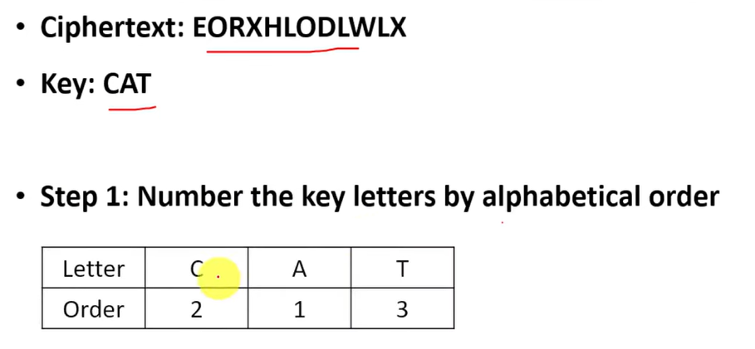
Decryption

Slide 85
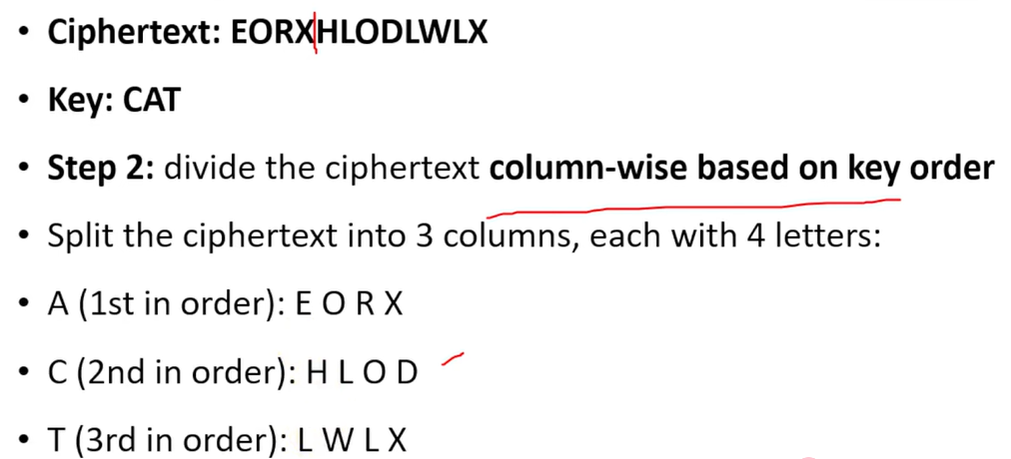

Slide 86
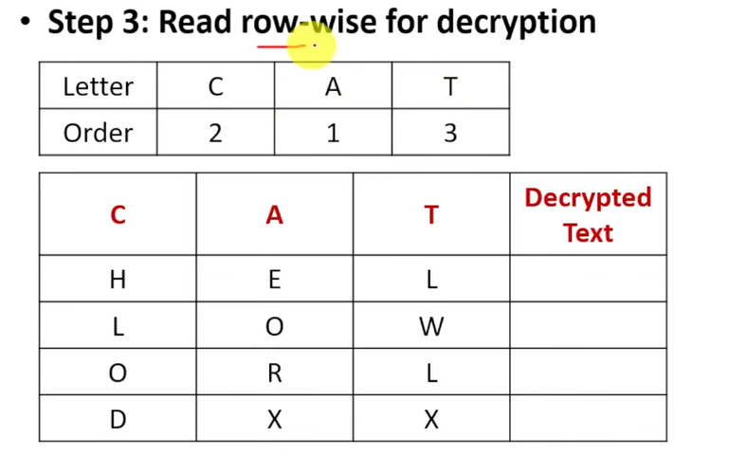

Slide 87
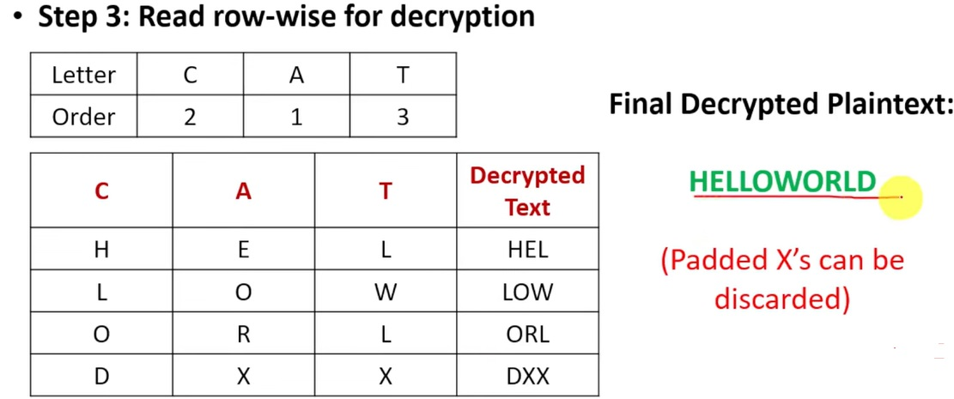

Slide 88
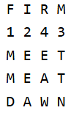
Fill the grid row by row using Key 1. Removing spaces and punctuation makes a tighter grid, but the tool will also accept them if you keep them.
Key 1: FIRM Plaintext: MEETMEATDAWN

Slide 89
Read columns in Key 1 order
Sort the key alphabetically (ties keep their left-to-right order) and read the columns in that order to form the intermediate text.
Key 1 order: F, I, M, R
Intermediate text: MMDEEATTNEAW

Slide 90
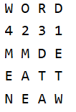
Write the intermediate text under Key 2
Repeat the same grid process using Key 2 and the intermediate text from the first pass.
Key 2: WORD
Intermediate text: MMDEEATTNEAW

Slide 91
Read columns in Key 2 order
Read the Key 2 columns in order to produce the final ciphertext.
Key 2 order: D, O, R, W Ciphertext: ETWMAEDTAMEN
Decrypt by reversing the order
To decrypt, rebuild the Key 2 grid column-by-column to recover the intermediate text, then repeat with Key 1 to recover the plaintext.
Ciphertext: ETWMAEDTAMEN
After Key 2: MMDEEATTNEAW
After Key 1: MEETMEATDAWN

Slide 92
steganography
The term "steganography" is derived from the Greek word "steganos" which means "hidden or covered" and "graph" means "to write.“
Steganography is the practice of concealing information. It involves hiding data within an ordinary, non-secret file or message to prevent detection.
The hidden information is being extracted at the receiving end.

Slide 93
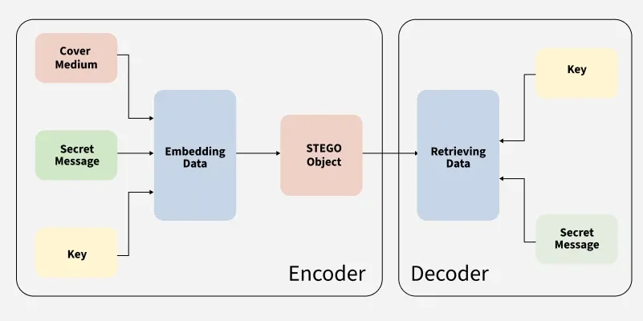

Slide 94
Step 1: The first step in steganography is selecting a cover medium which is the file or message that will carry the hidden data. Common cover media include:
Images (JPEG, PNG, BMP, etc.)
Audio files (MP3, WAV, etc.)
Video files (MP4, AVI, etc.)
Text files or documents
Step 2: Sometimes, before embedding, the secret message is encrypted to add an additional layer of security. This ensures that even if someone detects the hidden data, they cannot read it without the decryption key.

Slide 95
Step 3: The secret message is then hidden using one of several techniques:
Least Significant Bit (LSB): The least significant bit of a byte is changed to hide the secret message. This method is often used in image and audio files.
Frequency Domain: Instead of modifying the raw data (like pixels or audio samples), the secret message can be embedded in the frequency components of an image or audio file.
Bit Planes: In this method, data is hidden in the higher-order bit planes of an image. This can be more secure because it uses bits that are less likely to be noticed.
The most common is Least Significant Bit (LSB) encoding.

Slide 96
Step 4: The modified data is then embedded into the cover medium. The resulting file which now contains both the cover data and the hidden message is referred to as the stego-object which can be safely transmitted or stored without raising suspicion.
Step 5: The receiver of the stego-object needs to know the method used for embedding the secret message. In some cases, a secret key is required to extract the data if encryption is used in combination with steganography.

Slide 97
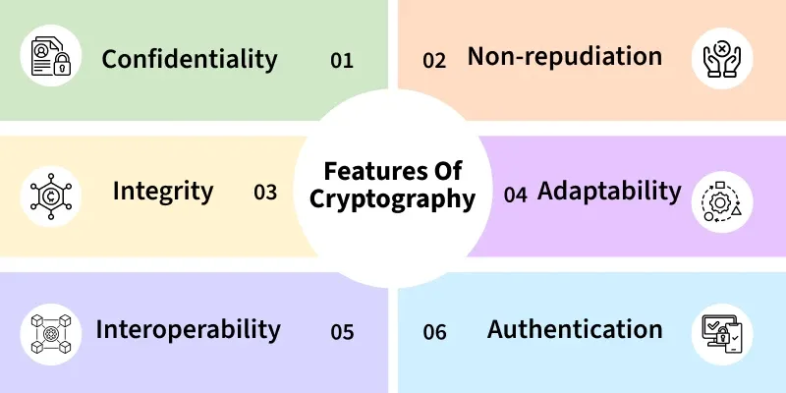
Cryptography

Slide 98
Confidentiality: Information can only be accessed by the person for whom it is intended and no other person except him can access it.
Non-repudiation: The creator/sender of information cannot deny his intention to send information at a later stage.
Integrity: Information cannot be modified in storage or transition between sender and intended receiver without any addition to information being detected.
Adaptability: Cryptography continuously evolves to stay ahead of security threats and technological advancements.
Interoperability: Cryptography allows for secure communication between different systems and platforms.
Authentication: The identities of the sender and receiver are confirmed. As well destination/origin of the information is confirmed.

Slide 99
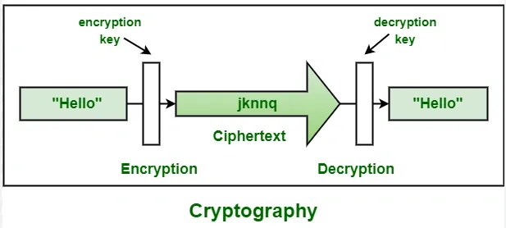
Working of a cryptography

Slide 100
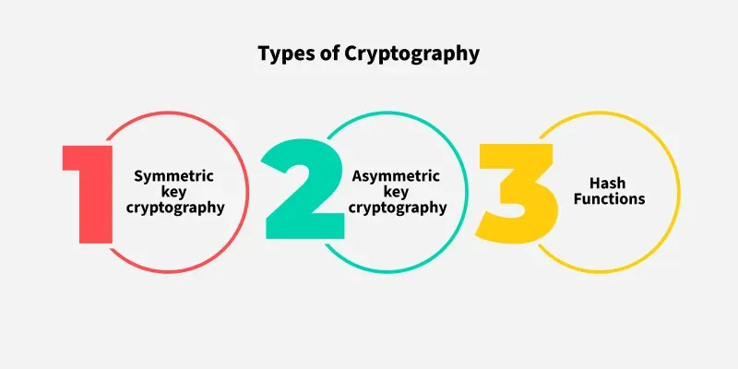

Slide 101
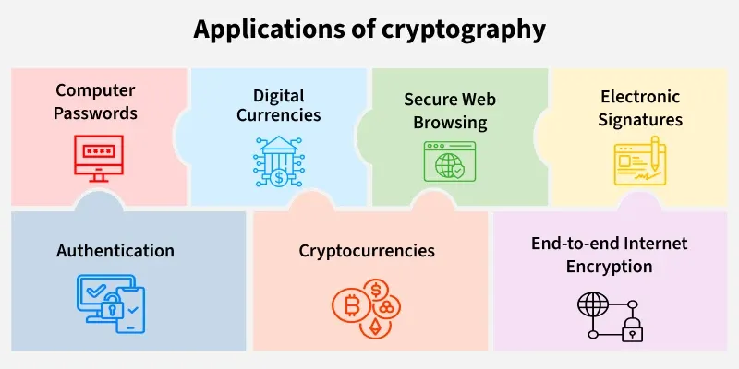

Slide 102
Block and Stream Cipher
Block ciphers encrypt data in fixed-size chunks (blocks), like 128 bits, using complex substitutions and permutations (e.g., AES), good for large data storage;
Stream ciphers encrypt bit-by-bit or byte-by-byte, generating a keystream XORed with plaintext (e.g., RC4), ideal for real-time, continuous data streams

Slide 103
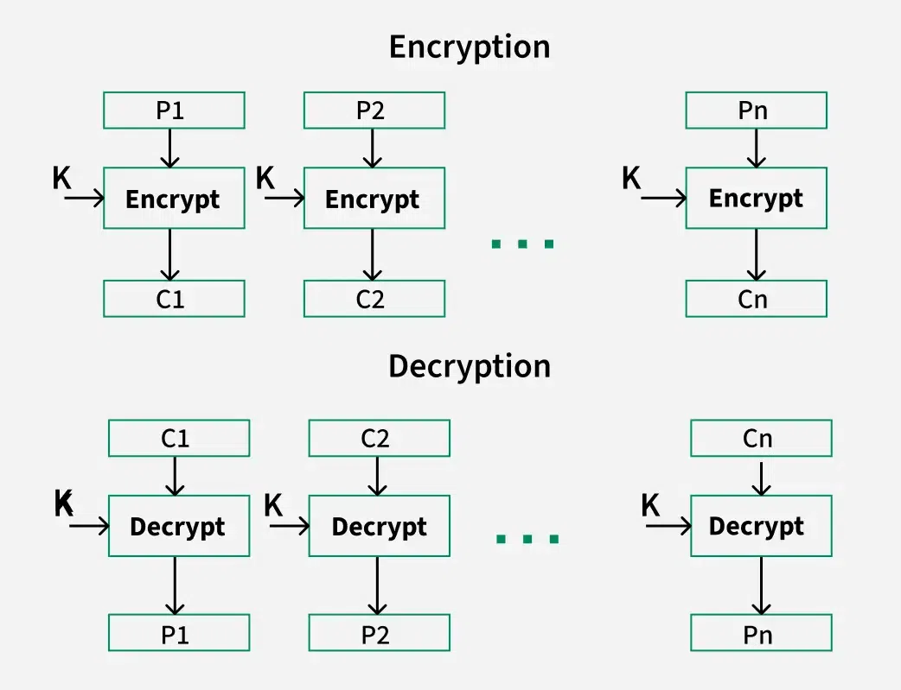
Block Cipher

Slide 104
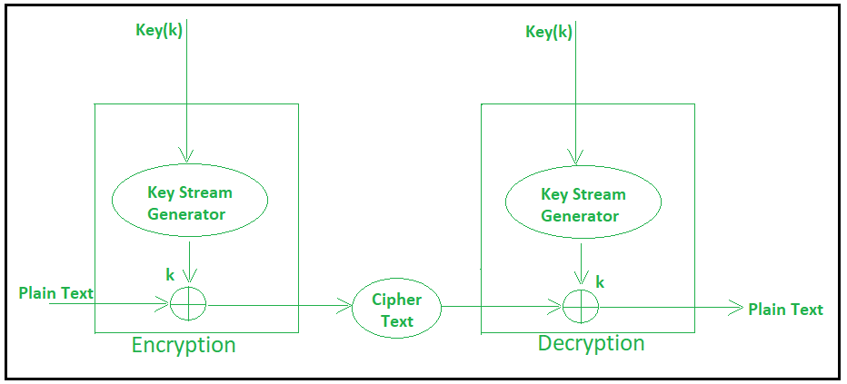
Stream Cipher

Slide 105
Data Encryption Standard
Data Encryption Standard (DES) is a symmetric block cipher. By 'symmetric', we mean that the size of input text and output text (ciphertext) is same (64-bits).
The 'block' here means that it takes group of bits together as input instead of encrypting the text bit by bit.
Data encryption standard (DES) has been found vulnerable to very powerful attacks and therefore, it was replaced by Advanced Encryption Standard (AES).

Slide 106
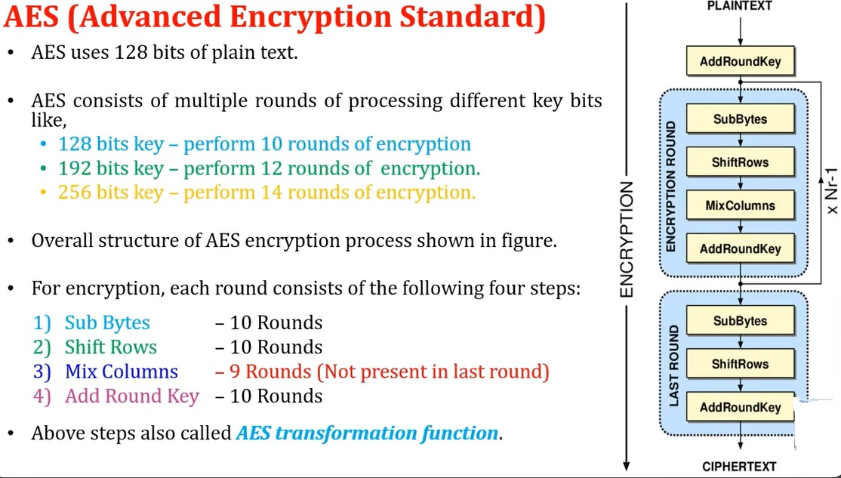

Slide 107
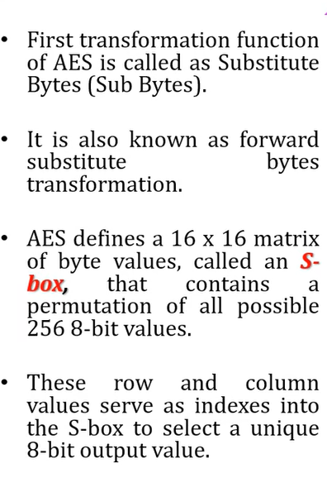
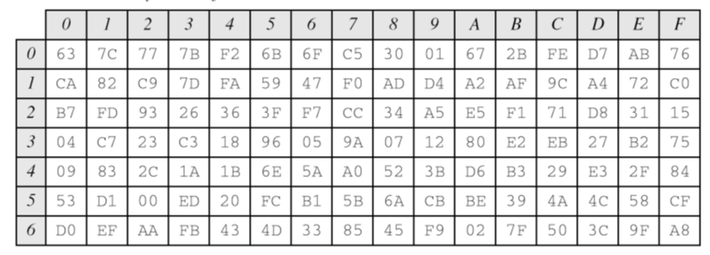

AES Subbytes

Slide 108


Slide 109


Slide 110


Slide 111


Slide 112


Slide 113


Slide 114


Slide 115


Slide 116


Slide 117


Slide 118


Slide 119


Slide 120


Slide 121

Hash Function
Hash functions are mathematical operations that "map" or change a given collection of data into a fixed-length bit string that is referred to as the "hash value."
Hash functions have a variety of complexity and difficulty levels and are used in cryptography.
Cryptocurrency, password security, and communication security all use hash functions.

Slide 122
Cryptographic hash functions are mathematical algorithms that transform input data into a fixed-length sequence of characters, referred to as a hash value.
Cryptographic hash functions are intended to be fast, deterministic, and one-way, meaning that even a minor change in input yields a very different hash.
These functions are important for securing information digitally by allowing data verification and authentication.

Slide 123
Properties of Cryptographic Hash Functions
Deterministic: The same input always generates the exact same hash output, ensuring consistent and reliable verification of data.
Fast Computation: Cryptographic hash functions are designed to process inputs quickly and efficiently, making them practical for handling large datasets and real-time applications.
Pre-image Resistance: It is computationally infeasible to reverse-engineer or retrieve the original input data from its hash value, protecting sensitive information from exposure.
Collision Resistance: The function minimizes the chance that two distinct inputs will produce identical hash values, ensuring unique data fingerprints for security and integrity.
Avalanche Effect: Even a tiny change in the input, such as flipping a single bit, causes a significant and unpredictable change in the hash output, enhancing the function’s sensitivity to data modifications.

Slide 124
Popular Cryptographic Hash Algorithms
MD5 (Message Digest Algorithm 5)
Once widely used for data integrity and digital signatures, MD5 is now considered insecure due to vulnerabilities that allow attackers to generate hash collisions easily. Its speed and simplicity made it popular historically, but it is no longer recommended for security-critical applications.
SHA-1 (Secure Hash Algorithm 1)
SHA-1 improved upon MD5 with a longer hash length and better resistance to collisions. However, advances in computational power and cryptanalysis exposed weaknesses, leading to practical collision attacks. Consequently, SHA-1 is deprecated for most security uses, including SSL/TLS certificates and digital signatures.
SHA-2 Family (SHA-256, SHA-512)
The SHA-2 family is currently the industry standard for cryptographic hashing, offering robust security with longer hash outputs of 256 and 512 bits. These algorithms provide strong collision and pre-image resistance, making them the preferred choice for secure communication protocols, blockchain technologies, and password hashing.

Slide 125
SHA-3 (Keccak)
Adopted as the latest NIST standard, SHA-3 uses a unique sponge construction different from SHA-2, enhancing security and flexibility. It offers comparable hash lengths with improved resistance to certain types of attacks, making it suitable for applications demanding long-term security.
BLAKE2 & BLAKE3
Designed as high-speed, secure alternatives to SHA-2 and SHA-3, BLAKE2 and BLAKE3 deliver faster hashing without compromising security. BLAKE3, in particular, supports parallel processing and incremental updates, making it ideal for modern systems requiring both speed and strong cryptographic guarantees.

Slide 126


Slide 127


Slide 128


Slide 129

W_{t} = expanded message word of round t;
K_{t} = round constant of round t

Slide 130
Working of SHA-1
Initialization
Let's start with some initial values.
Set all five variables (h0 to h4) with the correct values.
Pre-processing
Prepare the message ready for hashing.
A '1' bit should be added to the message's end.
To set a maximum length for the message, append a few '0' bits.
At the end of the message, include the message's original length (in bits).
Processing
Divide the message into manageable parts and deal with each one separately.
There should be 512 bits in each section.
Divide the pieces into sixteen 32-bit words each.
Use a formula to extend these words into eighty 32-bit words.

Slide 131
Main loop
Go through every word and do some calculations.
Based on the position and values of the word, update the temporary variables.
As per these calculations, update the hash values.
Finalization
To get the final hash, combine the hash values.
Using a predetermined order, arrange the hash values to generate a 160-bit integer.

Slide 132


Slide 133
Public key Cryptography
Public key cryptography is a method of encrypting or signing data with two different keys and making one of the keys, the public key, available for anyone to use.
The other key is known as the private key.
Data encrypted with the public key can only be decrypted with the private key.
Because of this use of two keys instead of one, public key cryptography is also known as asymmetric cryptography.

Slide 134
How does TLS/SSL use public key cryptography?
Public key cryptography is extremely useful for establishing secure communications over the Internet (via HTTPS).
A website's SSL/TLS certificate, which is shared publicly, contains the public key, and the private key is installed on the origin server — it's "owned" by the website.
TLS handshakes use public key cryptography to authenticate the identity of the origin server, and to exchange data that is used for generating the session keys.
A key exchange algorithm, such as RSA or Diffie-Hellman, uses the public-private key pair to agree upon session keys, which are used for symmetric encryption once the handshake is complete.
Clients and servers are able to agree upon new session keys for each communication session, so that bad actors are unable to decrypt communications even if they identify or steal one of the session keys from a previous session.

Slide 135

RSA Algorithm

Slide 136
Let's say we choose p = 61 and q = 53.
n = p * q = 61 * 53 = 3233
(n) = (p-1)(q-1) = 60 * 52 = 3120
Let's choose e = 17 (a common choice).
d = 2753 (computed such that (17 * d) mod 3120 = 1)
So, the public key is (3233, 17), and the private key is (3233, 2753).

Slide 137
Encryption
To encrypt a message, the sender Uses the public key (n, e) provided by the recipient. Converts the plaintext message (m) into a ciphertext (c) using the formula −
c = m^e mod n.
Suppose we want to encrypt the message "HELLO". We convert it to ASCII: H(72) E(69) L(76) L(76) O(79).

Slide 138
We will encrypt each ASCII value separately −
H: C = 72^17 mod 3233 = 2103
E: C = 69^17 mod 3233 = 2464
L: C = 76^17 mod 3233 = 2190
L: C = 76^17 mod 3233 = 2190
O: C = 79^17 mod 3233 = 875

Slide 139
Decryption
Once the ciphertext (c) is received, the recipient uses their private key (n, d) to decrypt the message. Computes the plaintext message (m) using the formula −
m = c^d mod n.
The recipient receives the ciphertext (2103, 2464, 2190, 2190, 875).

Slide 140
They use their private key to decrypt each value −
M = 2103^2753 mod 3233 = 72 (H)
M = 2464^2753 mod 3233 = 69 (E)
M = 2190^2753 mod 3233 = 76 (L)
M = 2190^2753 mod 3233 = 76 (L)
M = 875^2753 mod 3233 = 79 (O)
the decrypted message is "HELLO".

Slide 141


Slide 142


Slide 143


Slide 144


Slide 145


Slide 146
Digital Certificate
A Digital Certificate referred to as a public key certificate, is used to establish a cryptographic link between the owner of a public key and that entity. These are used to exchange public keys needed for authentication and encryption.
The certified public key, metadata about the certificate holder, identity information about the public key, and a digital signature of the public key created by the certificate issuer make up a digital certificate.

Slide 147
It is basically a certificate issued digitally, issued to verify a user's authenticity i.e., verifying the user sending a message is who he or she claims to be, and also to provide the receiver with the means to encode a reply.
Whoever wants to or an individual who wants to send encrypted messages applies for a digital certificate from a Certificate Authority (CA).

Slide 148

Need of digital certificate
The digital certificate allows entities to share their public key in an authenticated way.
They are used in initializing and establishing secure SSL (Secure Sockets Layer) connections between web browsers and web servers.

Slide 149
Digital Signature
A digital signature or a digital code which is generated and authenticated by public key encryption is a mathematical scheme verifying the authenticity of digital messages or documents.
The digital signature is based on RSA and public key cryptography which depends on two mutually authenticating cryptographic keys.
The creator and the sender creating the digital signature uses his/her own private key to encrypt signature-related data and to decrypt that data the signer's public key is used which is the only key to decrypt it.

Slide 150
Purpose of digital signature
It is attached to an electronically transmitted document verifying its contents and the sender's identity authenticating him.
It is used for software distribution, financial transactions, and contract management software.

Slide 151
Public Key Infrastructure (PKI)
Public Key Infrastructure (PKI) is a security framework that issues and manages digital certificates to establish trust on digital networks. It ensures secure communication by validating identities, protecting data, and preventing unauthorized access.
Provides unique digital identities to users, devices, and systems
Secures communication using public and private key pairs
Prevents MITM attacks by verifying key ownership
Ensures confidentiality, integrity, and authenticity of data

